Slide 1
Advancing
FOCUS
FOCUS

Slide 2
Notes:
All right, let's get going here.
How we doing tonight?
Okay
So we begin,
With…
Hello…
It is very possible that
You may recognize me

Slide 3



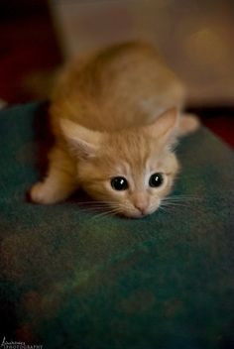

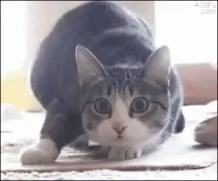

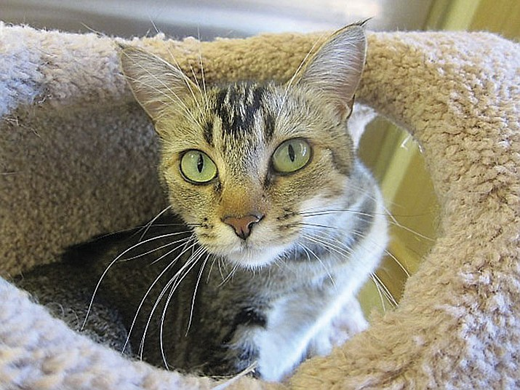


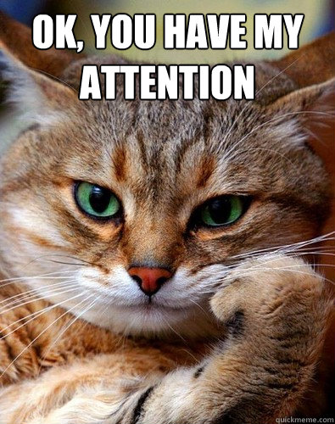
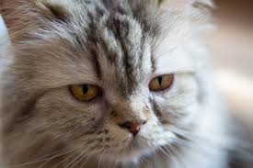
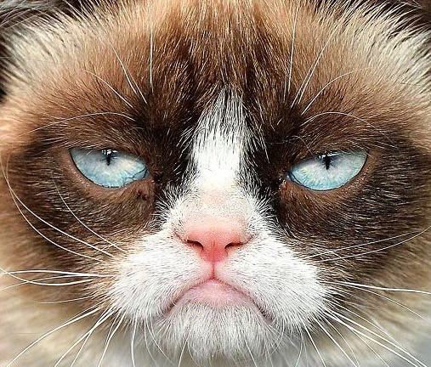
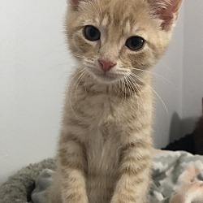
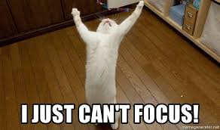

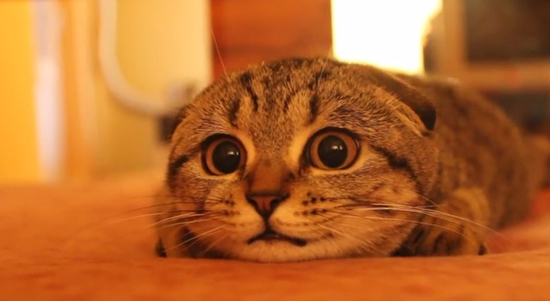






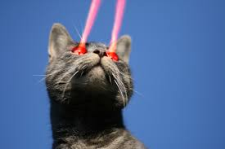


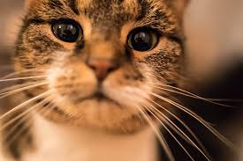
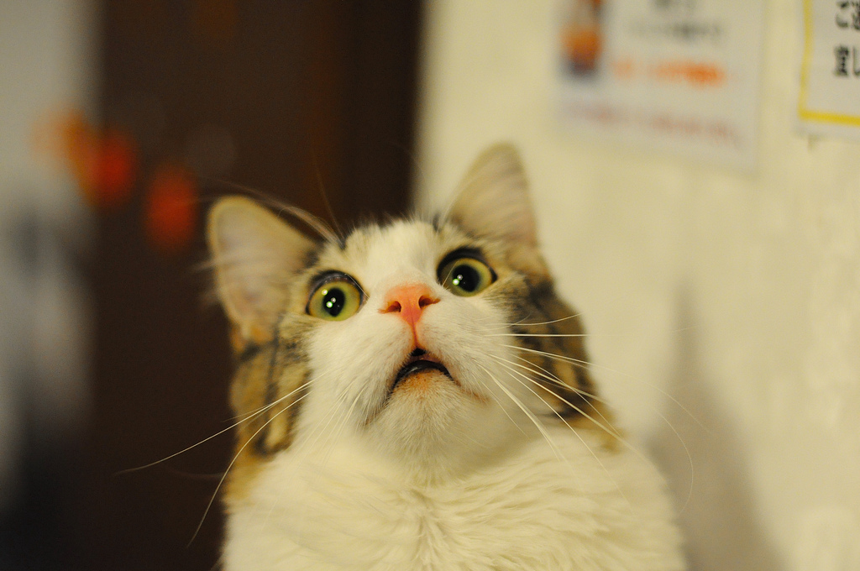
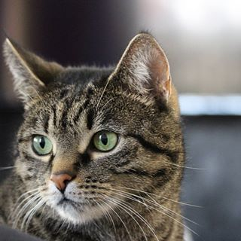


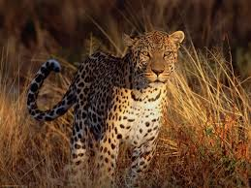




Notes:
All right, let's get going here.
How we doing tonight?
Okay
So we begin,
With…
Hello…
It is very possible that
You may recognize me

Slide 4

Notes:
No, I’m not Anthony Edwards…

Slide 5
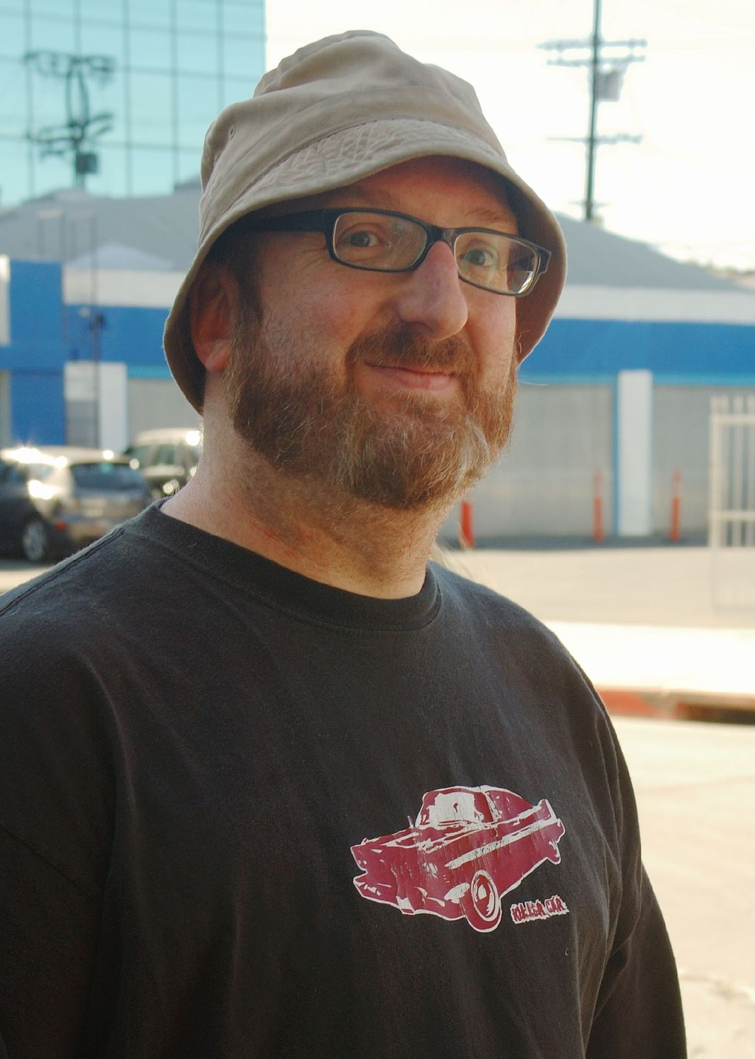
Notes:
Nor am I Brian Poeshen.

Slide 6
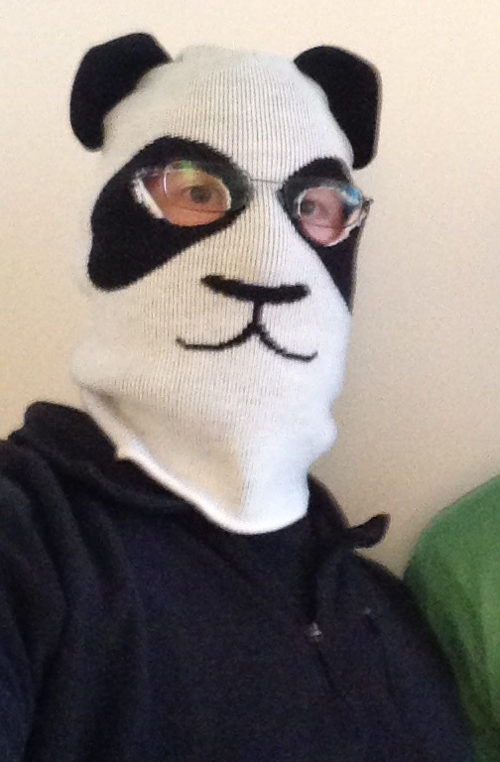
Notes:
And I’m not…
No, wait, that is me.
Long story.
Anyways,

Slide 7
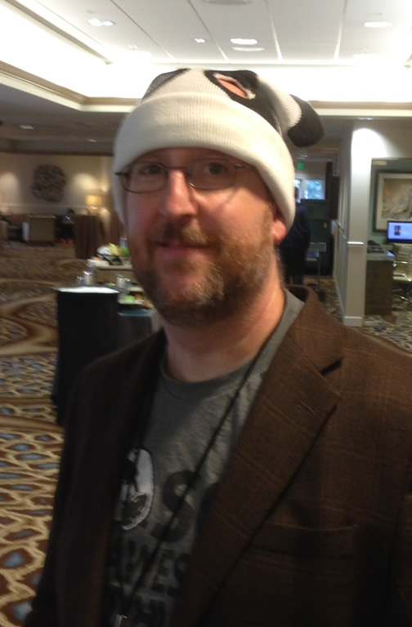



Glen R. Goodwin
@areinet
arei.net
github.com/arei
Notes:
Here I am.
You might know me from here at CharmCityJS
Or NodeSchool
Or from around the community.
But if you don’t…
these are my places…
<pause>
and I work for this company

Slide 8

Notes:
The Awesome Engineering Company.
Which makes libraries and enterprise applications
In nodejs for handling massive scale.
I'll hit you with a sales pitch in a few minutes.
But for now I'm here to talk to you about

Slide 9
Why are you “Awaiting”
to use Async!
Notes:
Why Are You "Awaiting" to use Async!
(Something about this font makes me want to modulate my tone
Make it sound more baritone, more grandious!
So yea, today we are talking about async/await…
BUT!

Slide 10
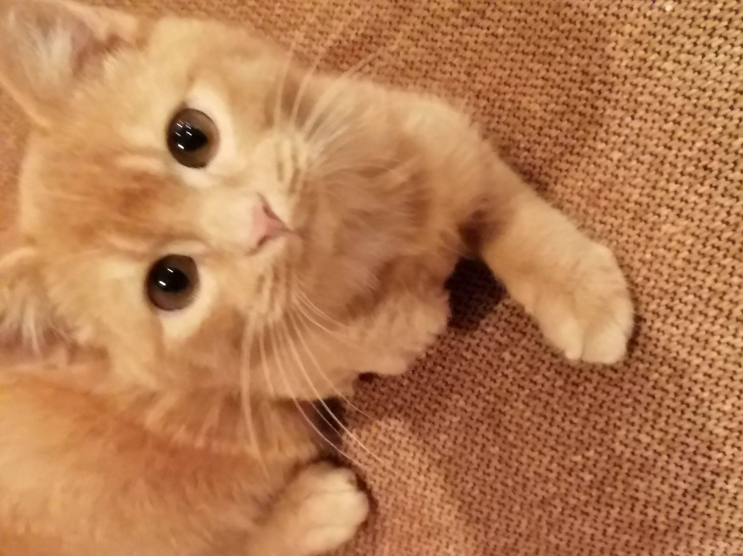
Glen R. Goodwin
@areinet
arei.net
github.com/arei
Awesome Engineering
github.com/awesomeeng
npmjs.com/org/awesomeeng

